Slide 1
Siddhanath Science Campus, Kanchanpur
Home Health Care System
Submitted By;
Yogendra Dhami (11310/073)
Submitted for the internship report
of
B.Sc. CSIT
in
Computer Science and IT
DEPARTMENT OF COMPUTER SCIENCE AND IT
Nov- 2021

Slide 2
Content
Introduction
Objectives
Methodology
Requirement Analysis
Feasibility Studies
Working tools and Technologies
Implementation
Testing
Benefits
Limitations
Home Health Care System
Nov- 2021
2

Slide 3
1. Introduction
A home health care system is a one kind of digital way to provide health related services to sick peoples that help to give services to the peoples.
It is designed to help patients to routinely check up them at their place only and also they don’t need to visit hospital small health related problems and also they can buy their medicine by placing order on this site and there is both kinds of payment system thorough online and cash.
Home Health Care System
Nov- 2021
3

Slide 4
2. Objectives
To provide a all the daily routine services such as dressing the wounds I nject medicine send the blood sample urine and other samples to the labs etc.
To save money and time of the patients we provide the services at any place that patient required.
To manage personal health related issues.
To provide authentication services to secure log in and store data.
To review the reports daily, weekly, monthly or yearly.
To visualize incomes and expenses.
Home Health Care System
Nov- 2021
4

Slide 5
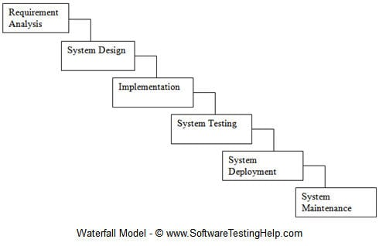
3. Methodology
Methodology used to reach the objectives of the project.
It shows the steps, phases, milestones, and evolution of the software development process.
The framework in which software is designed, developed, and maintained is known as the Software Development Life Cycle (SDLC).
We have used the Waterfall Model to develop our entire system
Fig. Waterfall Model
Home Health Care System
Nov- 2021
5

Slide 6
4. Requirement Analysis
Functional Requirements
Dashboard Panel
Medicine Panel
Service Panel
Non-Functional Requirements
Usability
Reliability
Supportability
Security
Availability
Portability
Home Health Care System
Nov- 2021
6

Slide 7
5. Feasibility Study
Technical Feasibility
focuses on the technical resources
Economical Feasibility
Operational Feasibility
Anyone with basic knowledge of sites, can operate
Schedule Feasibility
web
Home Health Care System
Nov- 2021
7

Slide 8
6. Working Tools and Technologies
Languages:
HTML5, CSS3, JavaScript, PHP
Libraries:
jQuery, Bootstrap;
Tools
VS Code, Laragon (for MySQL and Apache) , Sublime text editor ,Chromo Browser
Home Health Care System
Nov- 2021
8

Slide 9
7. Implementation
Login
This is the first module of system. Once the registration is done the user can login to the system. Login module will ask user to provide username and password.
Dashboard
The user is directed to this page once login is done successfully. From this page now the user can perform operations that the user wishes to perform.
The options available are: Teacher manager, Student Manager, Result manager, Subject Manager, Search box, Score management, user profile.
The system developed by us includes following modules as follows:
Home Health Care System
Nov- 2021
9

Slide 10
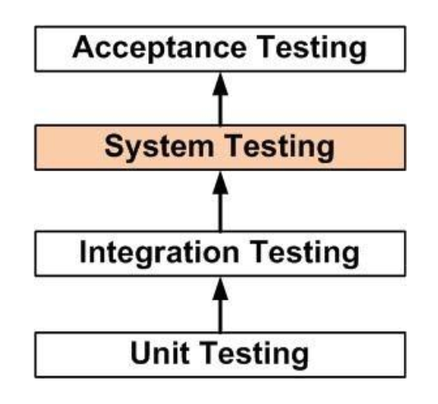
8. Testing
Unit Testing
Integration Testing
System Testing
Acceptance Testing
Fig. Step By Step Testing Process
Home Health Care System
Nov- 2021
10

Slide 11
9. Benefits
Home care reinforces and supplements care from the client’s family and friends.
Home care offers individualized services that are tailored to the client’s health care needs and finances.
It is helpful to maintain the patients health.
People can get service at their home.
Home Health Care System
Nov- 2021
11

Slide 12
10. Limitations
Being a web-based application; it requires internet for access which might not be possible for all users everywhere, every time.
Requires skilled technical personnel for CRUD (create, read, update, delete) operations of database which may not always be possible.
The risk of data mishandling might be creating a problem.
Database failure can be catastrophic and can lead to loss or corruption of
very important data and records
Home Health Care System
Nov- 2021
12

Slide 13
Thank You…

